Slide 1
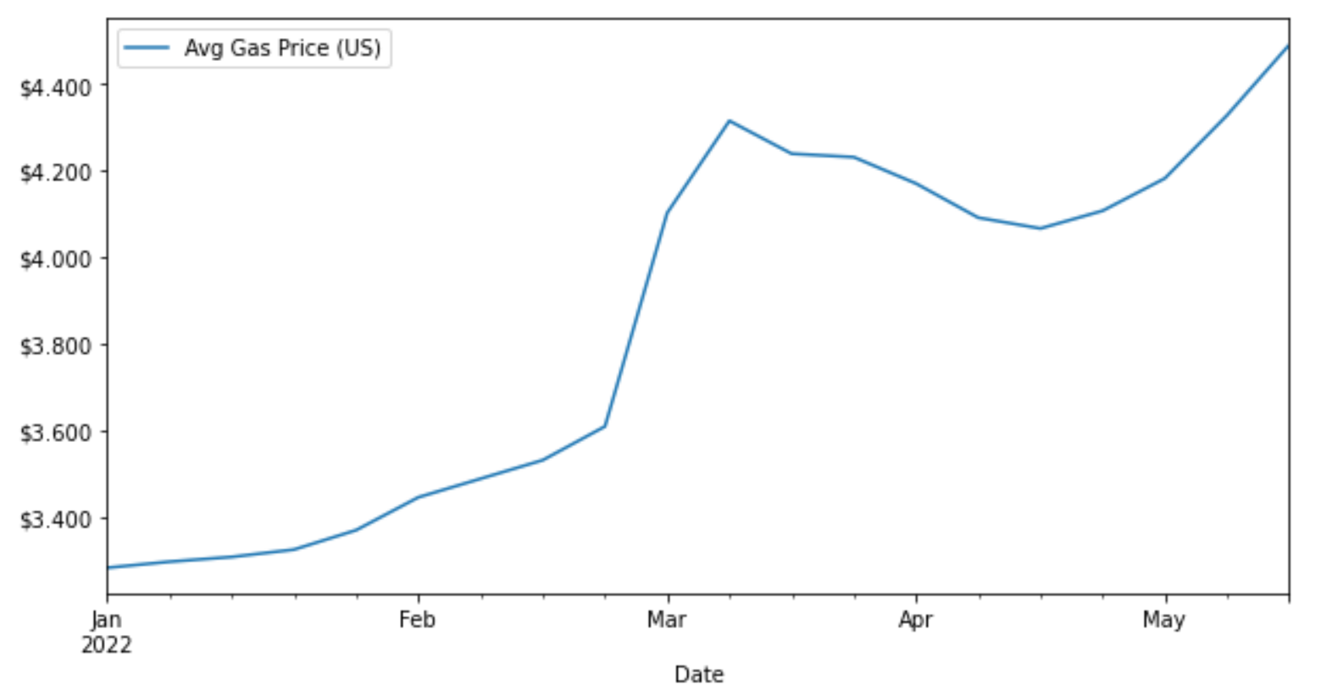
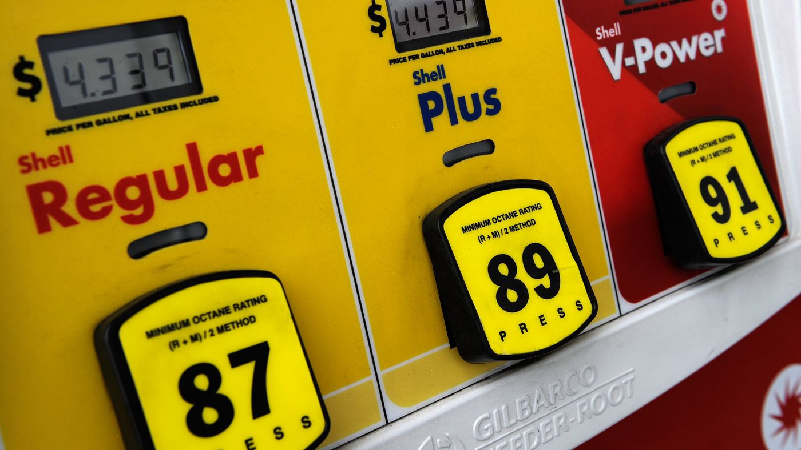
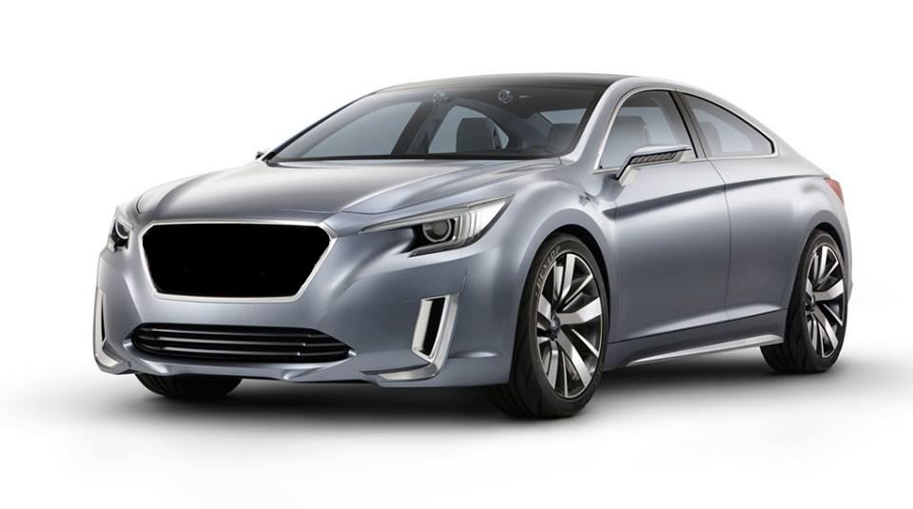
Best Vehicles in 2022 for your Gas Budget
https://www.vox.com/2014/8/19/6031445/gas-premium-regular-car-engine
http://swadeology.com/2013/11/can-name-car/

Slide 2
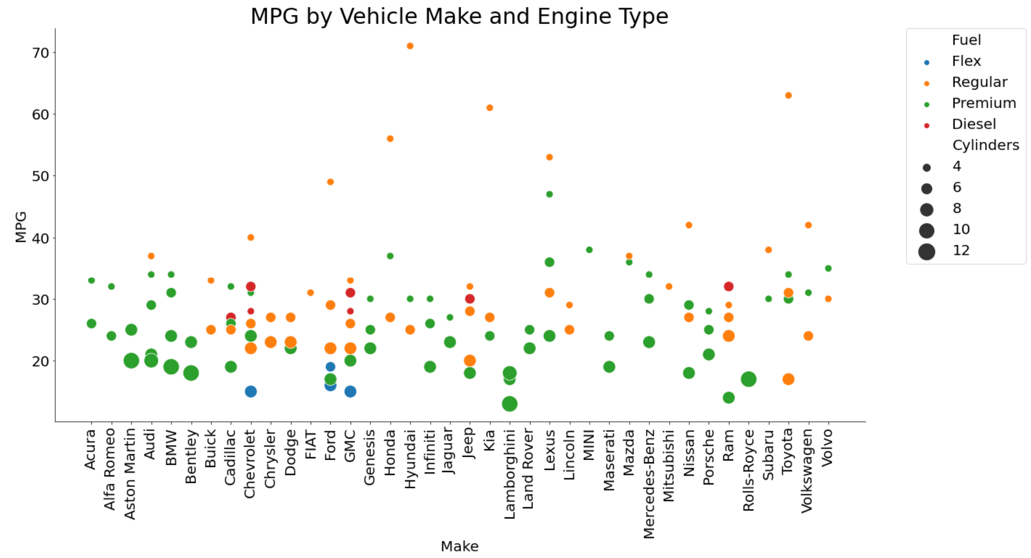
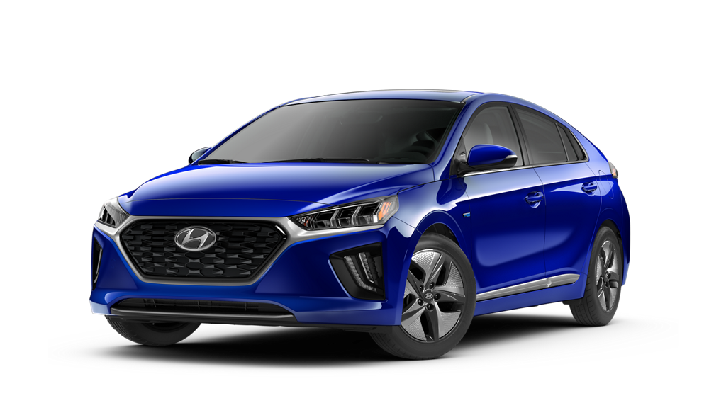
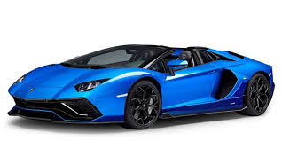
MPG varies greatly by Make and Engine Type
The Hyundai IONIQ Blue leads the pack with a 71 MPG hybrid engine
71 MPG
13 MPG
https://www.ccarprice.com/us/lamborghini-aventador-lp780-4-ultimae-roadster-2022-price-in-usa-8318
https://www.hyundaiusa.com/us/en/vehicles/ioniq-hybrid/compare-specs

Slide 3
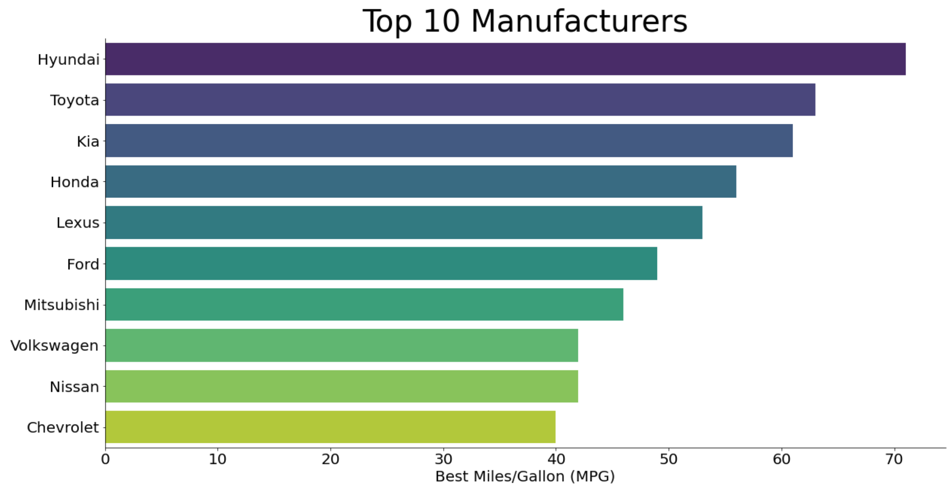
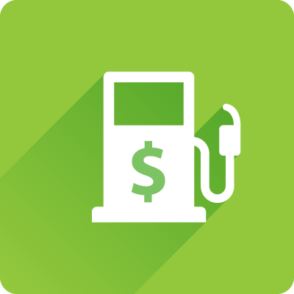
Not ready for an Electric Vehicle?
These manufacturers of gas engines provide vehicles having at least 40 MPG
https://marketplace.geotab.com/solutions/average-fuel-economy-report/

Slide 4
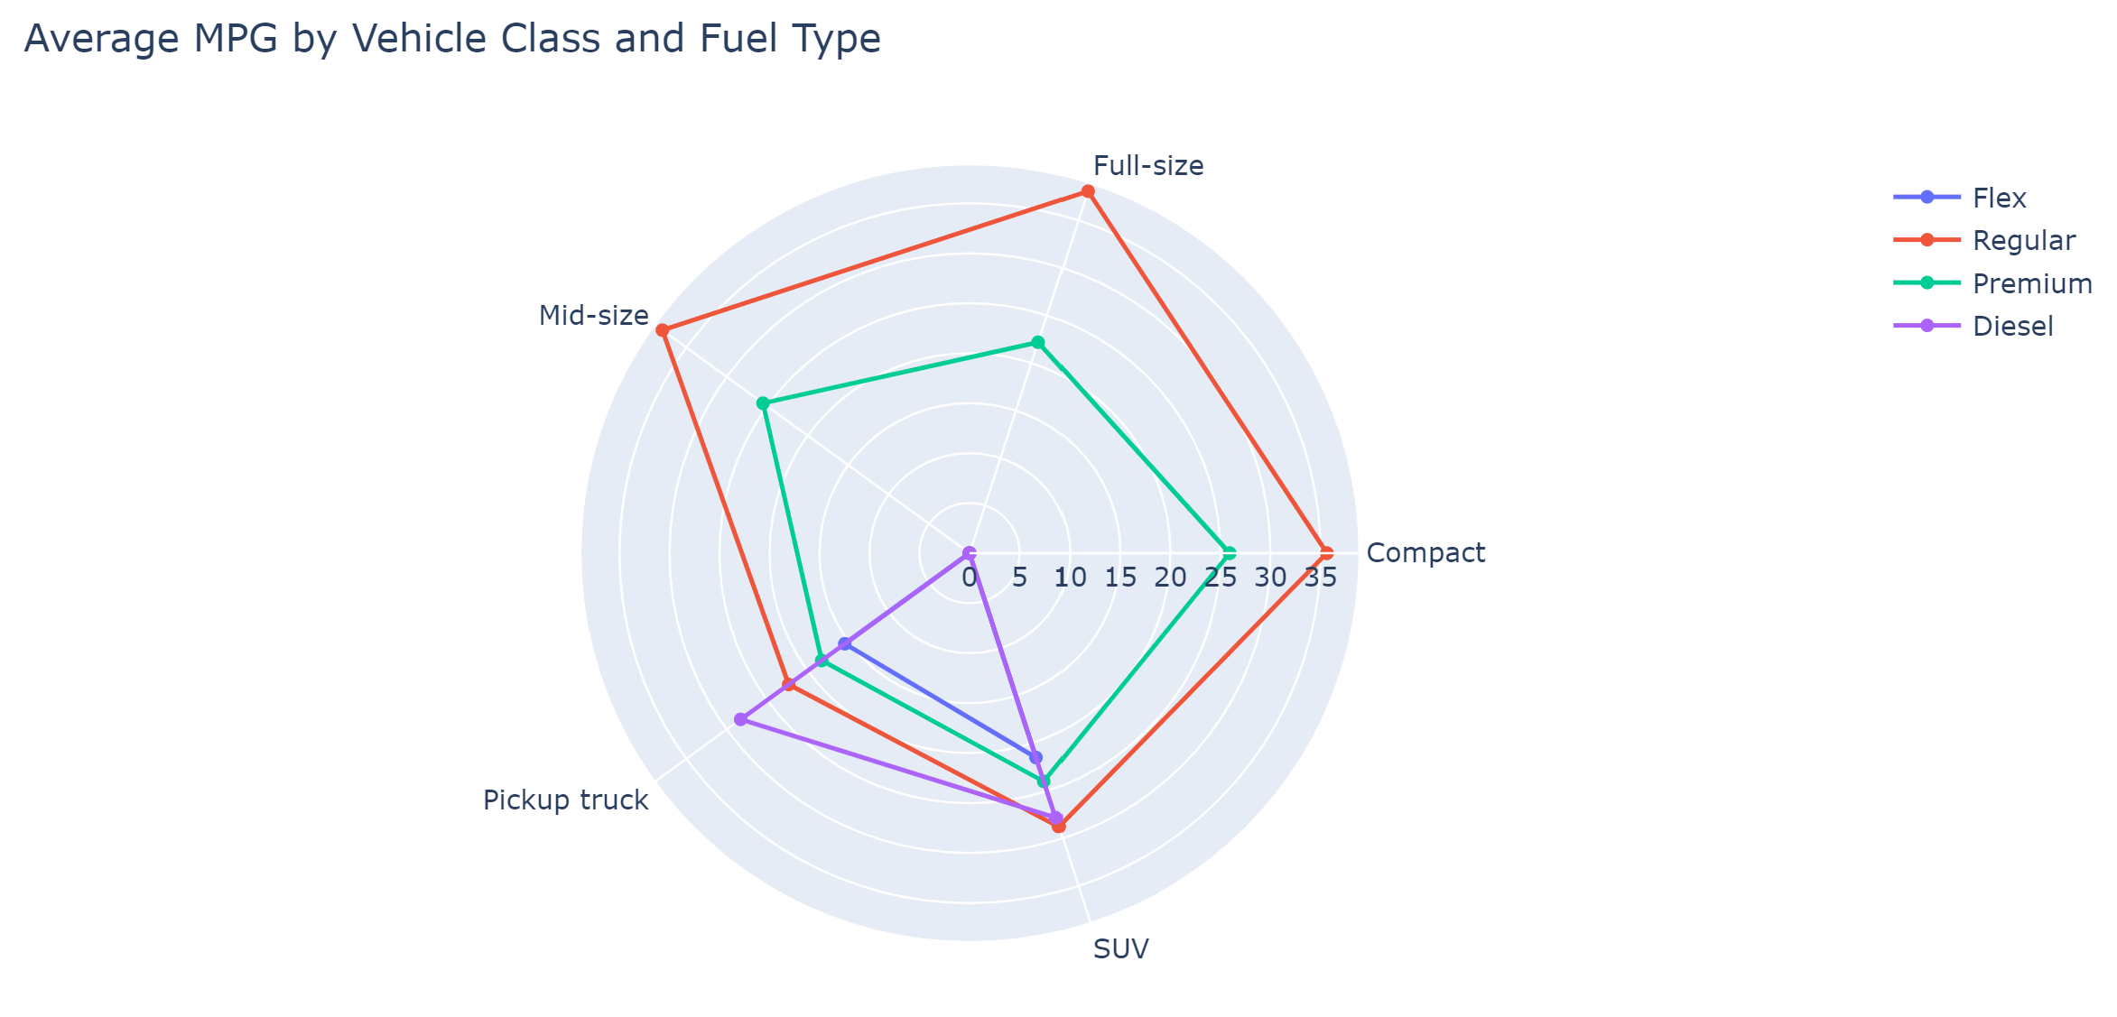
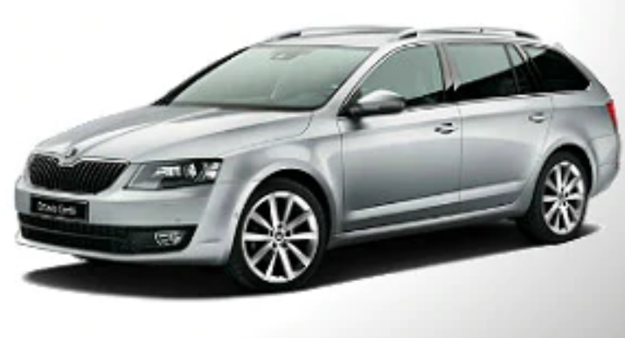
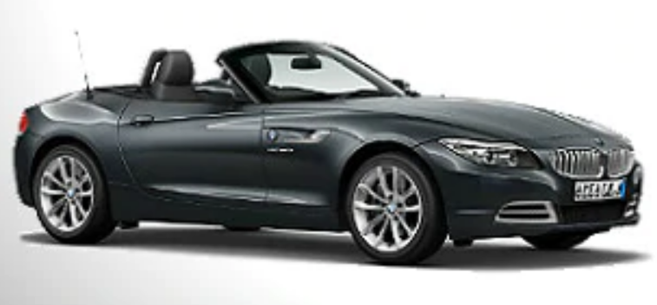
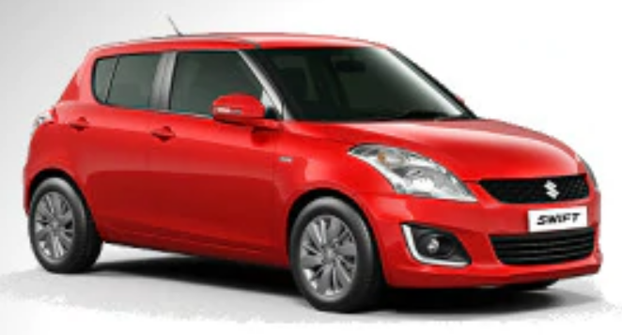
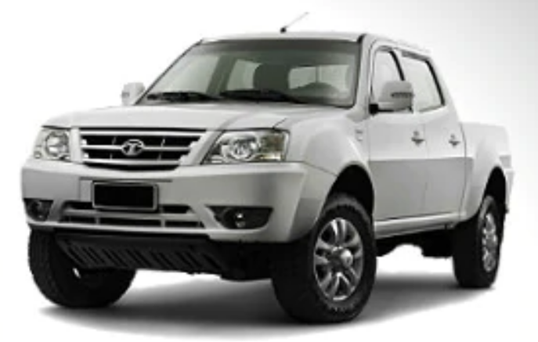
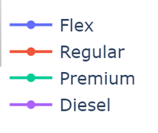
You don’t need a Compact car for great MPG
The average MPG for Mid-size and Full-size cars are better than Compact cars
https://www.kevianclean.com/blogs/news/5-different-types-of-cars-and-their-uses

Slide 5
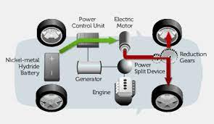
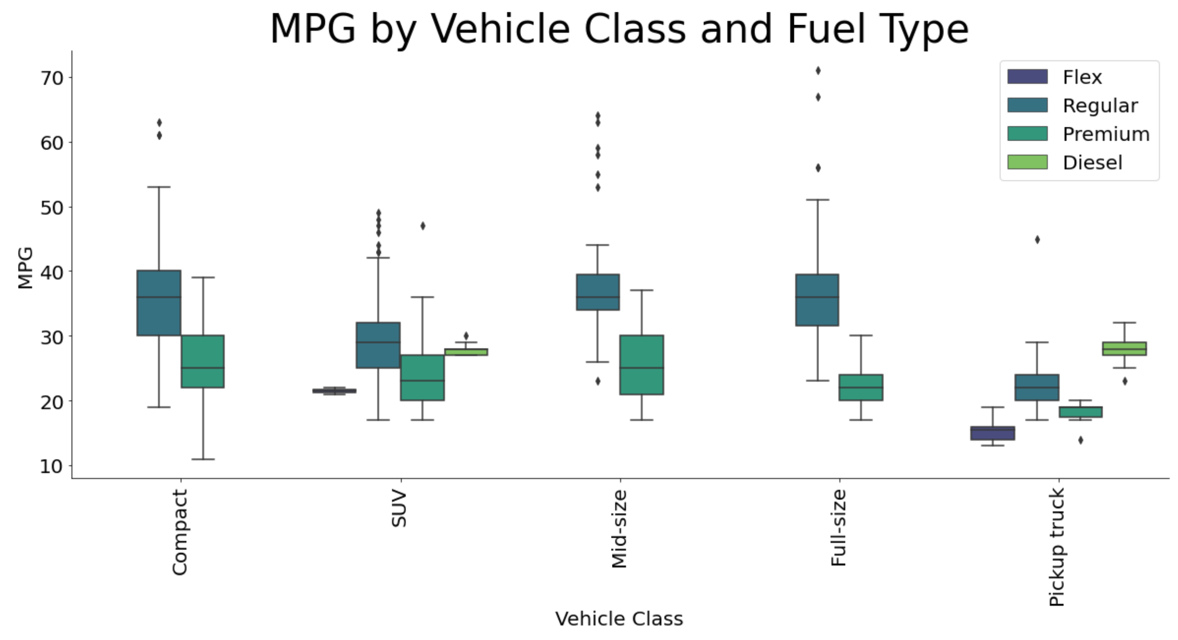
Regular (87 octane) Vehicles Top MPG
Hybrids combine Electric with Regular to push MPG well above the 75th percentile
https://nepalmechanical.blogspot.com/

Slide 6
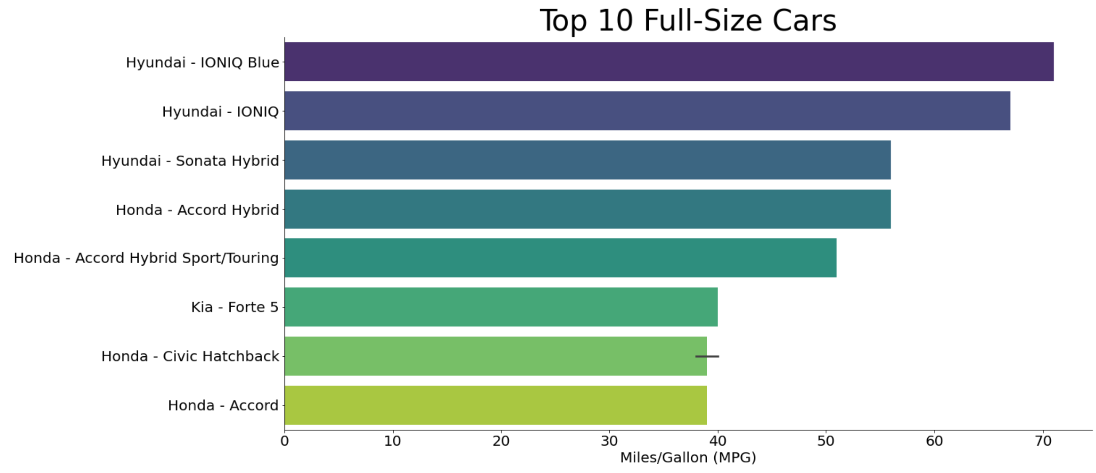
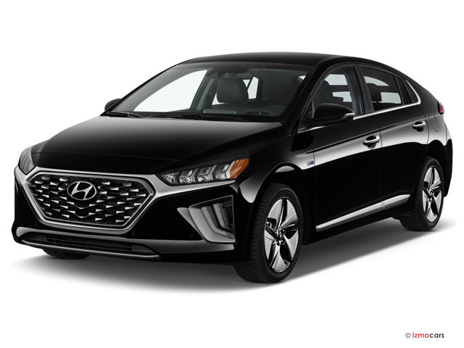
Top Full-Size Cars
Hyundai dominates the Full-Size class with 71 MPG
https://cars.usnews.com/cars-trucks/hyundai/ioniq

Slide 7
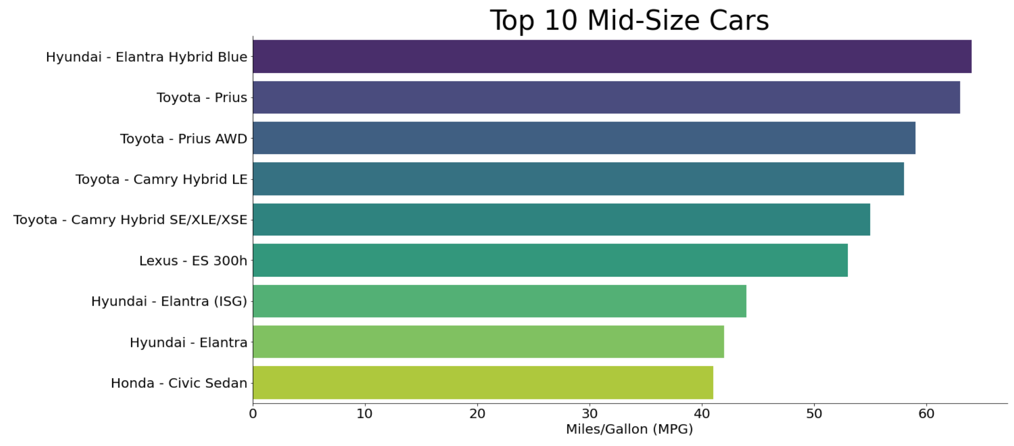
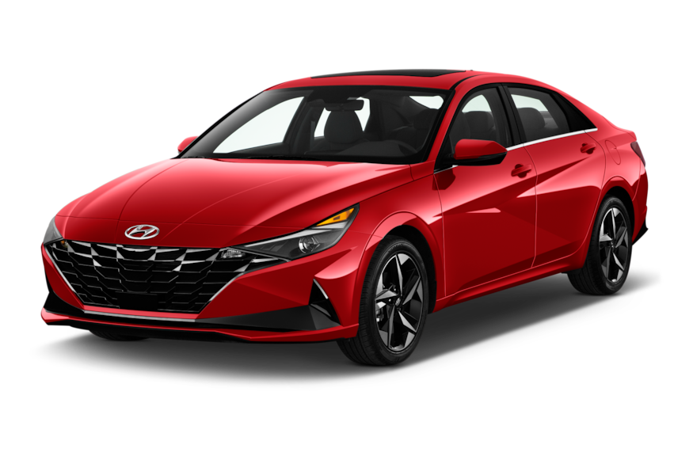
Top Mid-Size Cars
Hyundai Elantra Hybrid Blue overcomes the Prius with 64 MPG
https://www.motortrend.com/cars/hyundai/elantra-hybrid/

Slide 8
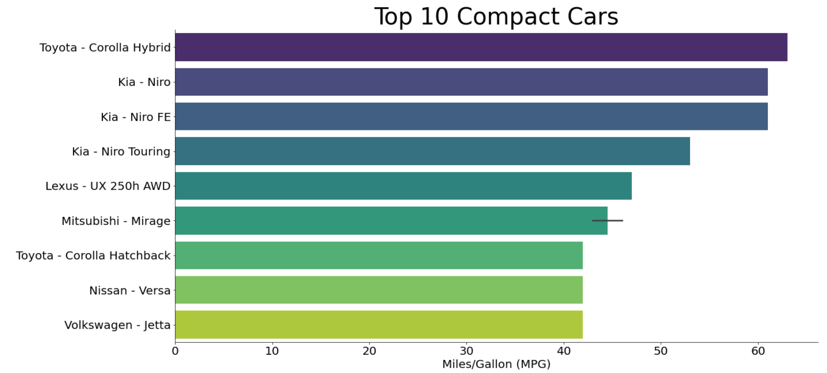
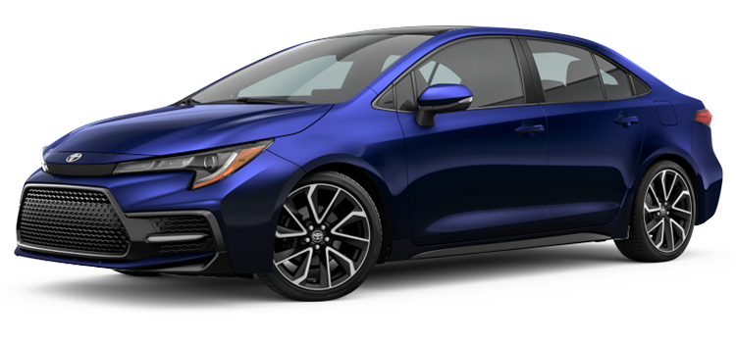
Top Compact Cars
Toyota Corolla Hybrid inches past Kia with 63 MPG
https://www.mikesmithdirect.com/carresearch/Build_Vehicle_Consumer/year_2022/make_Toyota/model_Corolla/trim_SE/section_ColorsOptionsBuild/id_48685/confid_carprices/

Slide 9
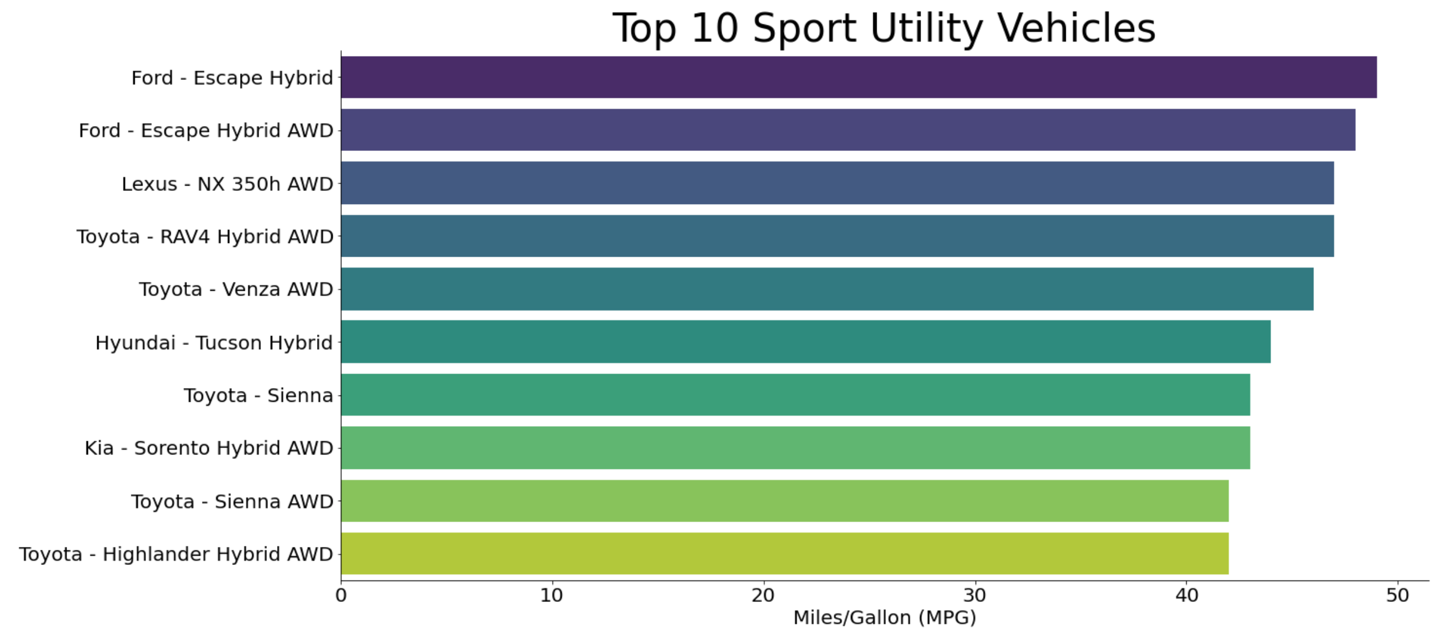
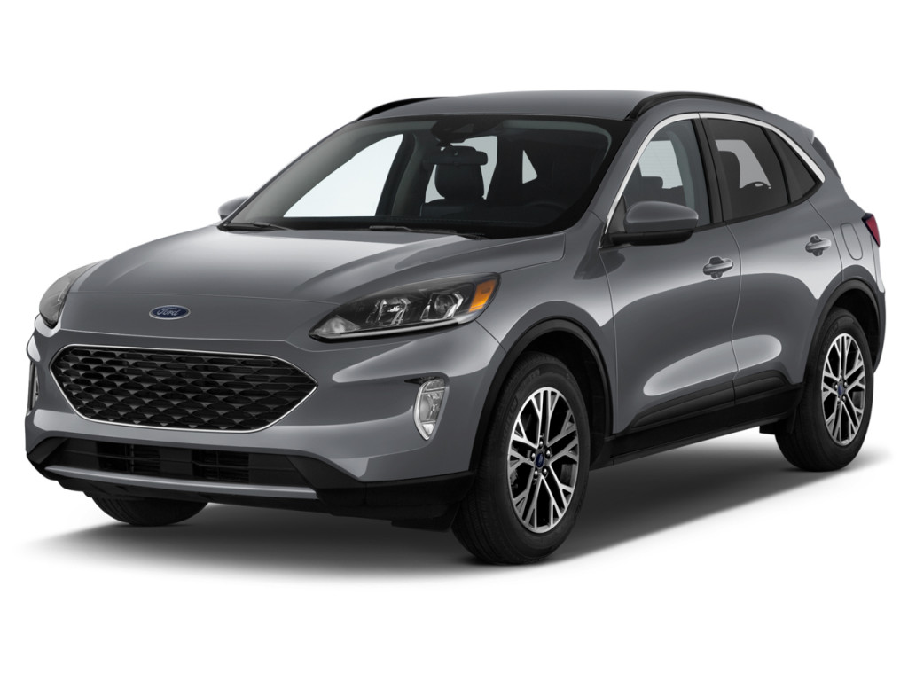
Top Sport Utility Vehicles
Ford Escape Hybrid edges out the SUV class with 49 MPG
https://www.thecarconnection.com/overview/ford_escape_2022

Slide 10
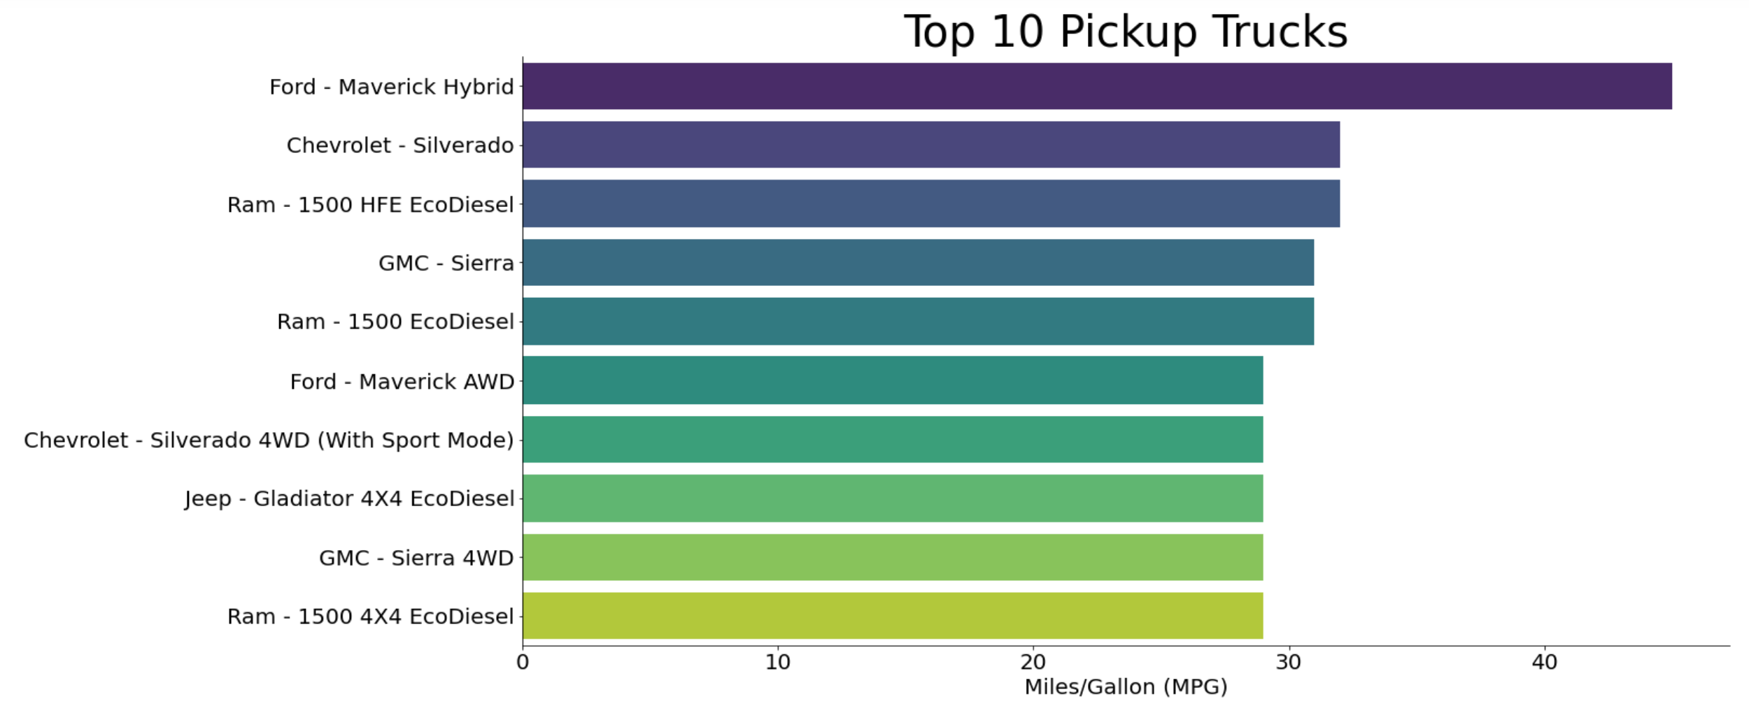
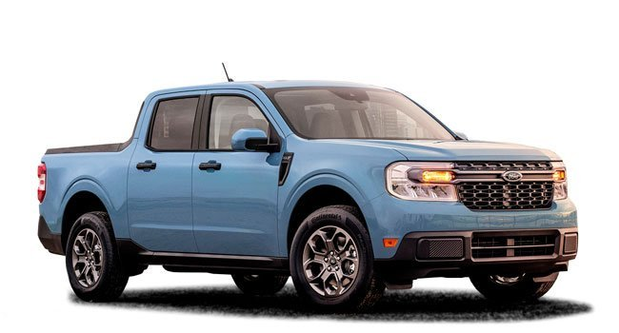
Top Pickup Trucks
Ford Maverick Hybrid outpaces the competition at 45 MPG
https://www.kevianclean.com/blogs/news/5-different-types-of-cars-and-their-uses

Slide 11
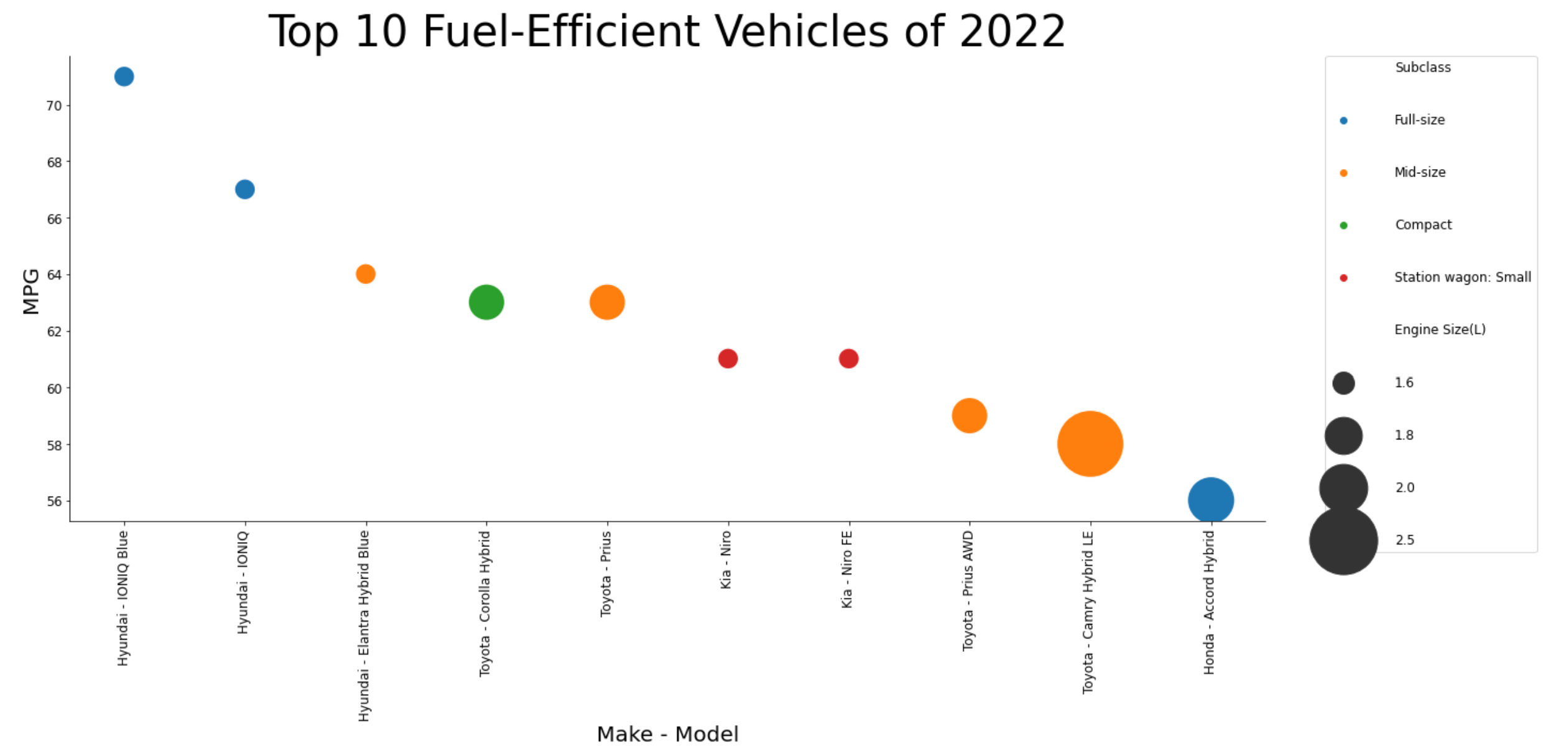
And the Winners are…
Hyundai IONIQ Blue – Best MPG @ 71 MPG
Toyota Camry Hybrid LE – Most powerful engine @ 2.5 liters
https://cars.usnews.com/cars-trucks/hyundai/ioniq

Slide 12
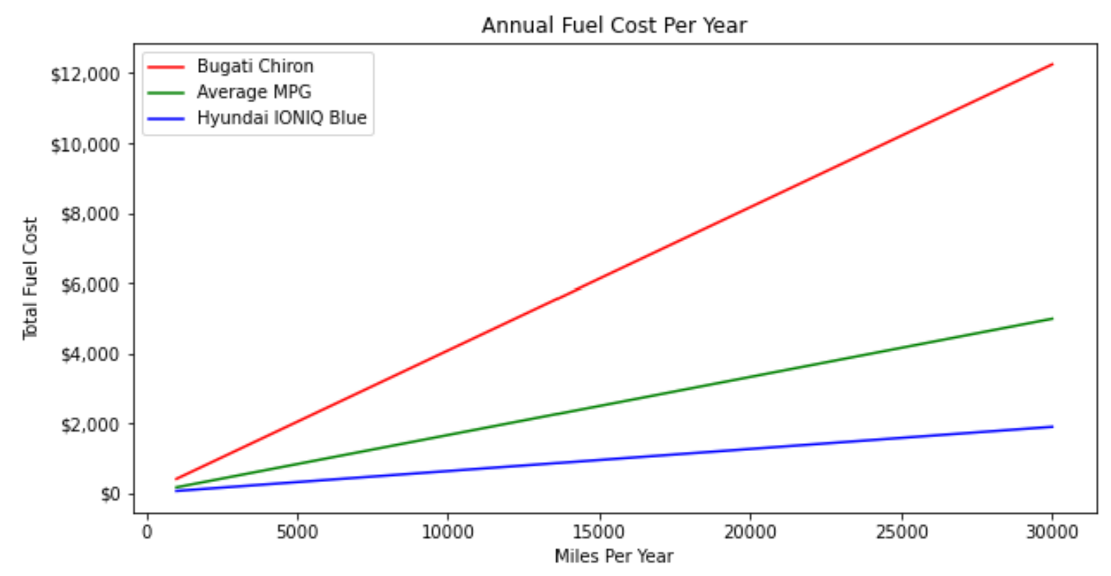
Annual Savings
Hyundai IONIQ Blue can save more than $10,000 per year in fuel costs over the Bugati Chiron
and save more than $2,000 per year in fuel costs over the average vehicle

